Slide 1
Surveillance Capitalism
Welcome to our Presentation

Slide 2

Definition
An economic system where companies collect, analyze, and sell personal data to predict and influence user behavior for profit. Also known as "The hidden trade of human experience for profit."
Surveillance Capitalism
- The Age of Surveillance Capitalism
- Shoshana Zuboff

Slide 3
Key concept
Surveillance Capitalism
Personal data as a key economic asset.
Monitoring and predicting behavior using algorithms.
Influencing consumer choices and decisions.
Market dominated by a few tech giants.

Slide 4
Impact
Surveillance Capitalism
On Economy: Privacy gone, choices controlled e.g., TikTok’s addictive feed.
On Society: Big tech owns ads, small businesses lose.
On Economy: Algorithms fuel anger and profit from it.

Slide 5
What can be done
Surveillance Capitalism
Protect Yourself: Control your data — use DuckDuckGo, Signal, turn off ad tracking, check privacy settings.
Fix the System: Support strong privacy laws (like GDPR) and fair rules to stop big tech monopolies.
Repair Society: Use ethical apps (Signal, Firefox) and demand transparent algorithms.

Slide 6
Data Collection
Every time we use the internet-like watching YouTube or using Facebook-companies collect our data.
Surveillance Capitalism

Slide 7
Behavioral Surplus
Companies often collect more data than they need.
Surveillance Capitalism

Slide 8
Machine Learning
Machine learning means teaching computers to learn from data
Surveillance Capitalism

Slide 9
Targeted Advertising
Finally, all this data is used for targeted advertising.
Surveillance Capitalism
P2

Slide 10
Examples and Real Word cases-
• Facebook and Instagram
• Google
• Local Examples
Surveillance Capitalism

Slide 11
Benefits of Surveillance Capitalism
Surveillance Capitalism
Personalized Services
Business Efficiency and Growth
Economic Value Creation
Predictive Capabilities
Public Safety and Smart Governance
Innovation in AI and Automation
Access and Inclusion
P3

Slide 12
Surveillance capitalism is a system where companies collect ,analyze and sell personal data to predict and influence human behavior for profit.
Surveillance Capitalism

Slide 13
Privacy Invasion-
Your life is there data. our online actions, searches ,likes , even GPS movements are constantly tracked.
Surveillance Capitalism

Slide 14
Consent issues-
Most people agree to data polices without reading them.
Surveillance Capitalism

Slide 15
Digital Inequality-
The power gape widens those with access to data gain enormous power , while those being mined for data have non.
Surveillance Capitalism

Slide 16
Legal gaps-
Laws are falling behind current laws are outdated and vary by country.
Surveillance Capitalism
P4

Slide 17
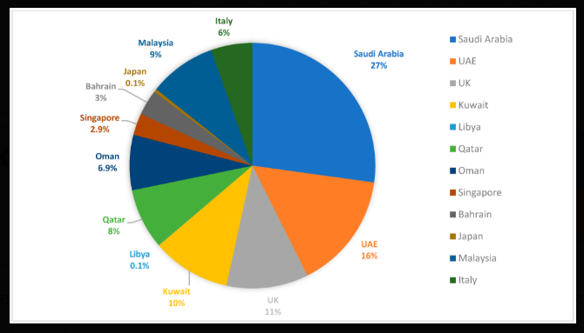
Surveillance Capitalism
This pie chart illustrates the world's surveillance capitalism business.
1. Explain The Pie Chart…..
2. Marking the highest Point ?
3. Who Is The Highest Level ?

Slide 18
Good Side of Surveillance Capitalism
Personalized User Experience
Better Products and Services
Efficient and Relevant Advertising
Economic Growth and Innovation
Access to Free Services
Improved Public Services
Fraud Detection and Security
Surveillance Capitalism

Slide 19
Bad Side of Surveillance Capitalism
Loss of Privacy
Manipulation of Behavior
Lack of Transparency and Consent
Data Breaches and Cyber security Risks
Power Imbalance
Erosion of Democracy and Free Will
Surveillance by Governments
Digital Inequality
Surveillance Capitalism

Slide 20
How appropriate is it for Bangladesh?
Surveillance Capitalism
The appropriateness of surveillance capitalism in Bangladesh is a complex and evolving issue. While it brings some potential benefits (like digital innovation and targeted services), it is largely considered problematic due to weak data protection laws, lack of transparency, and risks to civil liberties
P5

Slide 21
Thank you for staying with us.

